Slide 1
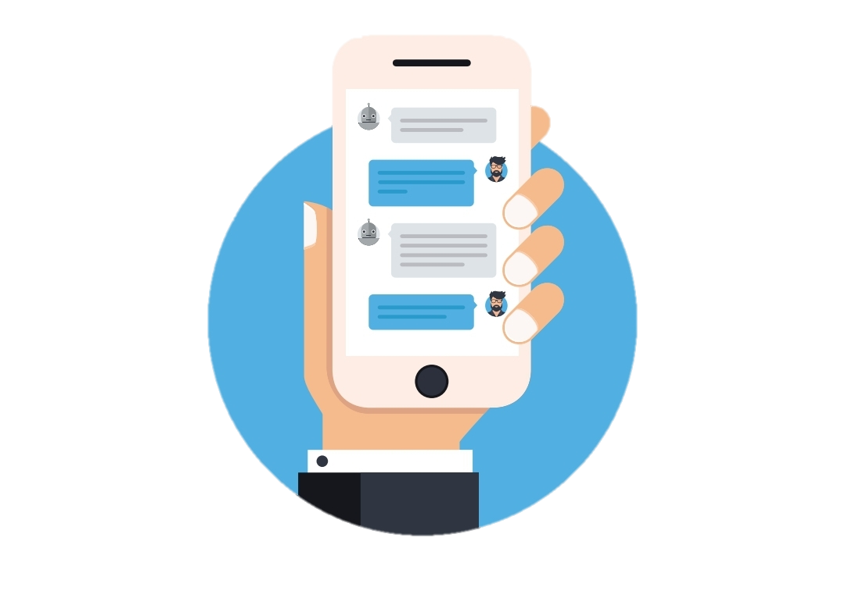
GROUP 10 TOPIC:- INTELLIGENT CHATBOT USING Python (A.I & M.L)
GUIDED BY:- Prof. Shashikant Patil

Slide 2
AGENDA
Sentinel
Introduction
Abstract
Building blocks of chatbots
Do Chatbots have inherent advantages over humans.
Why are chatbots steadily gaining attention?
Enterprises are finding multiple areas to deploy chatbots

Slide 3
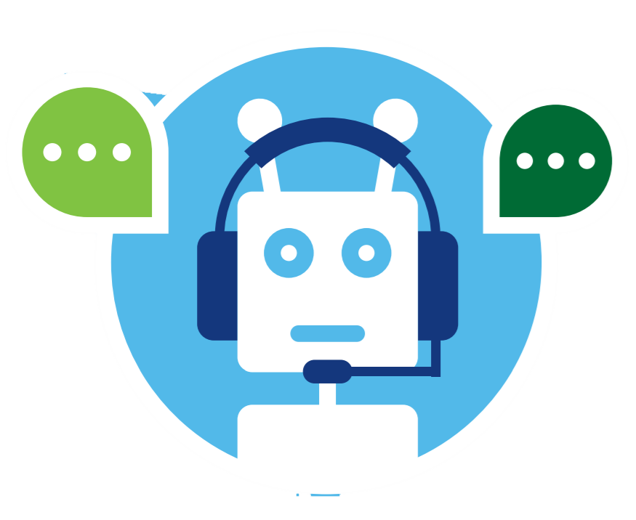
S e n t I n e l

Slide 4
Introduction
Chatbots are computer programs that maintain a conversation with a user in natural language, understand the user’s intent and send responses based on the organization’s business rules and data.
These chatbots use Artificial Intelligence to process language, enabling them to understand human speech.
They can decipher verbal or written questions and provide responses with appropriate information or direction
Chatbots also interact verbally with consumers, such as Siri on the Apple iPhone or Amazon’s Alexa Voice Service.

Slide 5
ABSTRACT
A chatbot is AI computer software that can act as a conversation through textual or auditory methods. The core of chatbots analyses a customer’s data using the artificial intelligence which integrates the response with them.
Different tasks can be replaced with AI-powered bots as they are much more powerful—and are capable of performing multiple tasks at once. Machine Learning techniques are basically used in the process of understanding the input that we get from the user and replying to the user.
Natural language processing allows a bot to have a conversation as naturally as possible. The ideal interaction between user and chatbot is a balanced mix of Innovative technology and human Intervention...

Slide 6
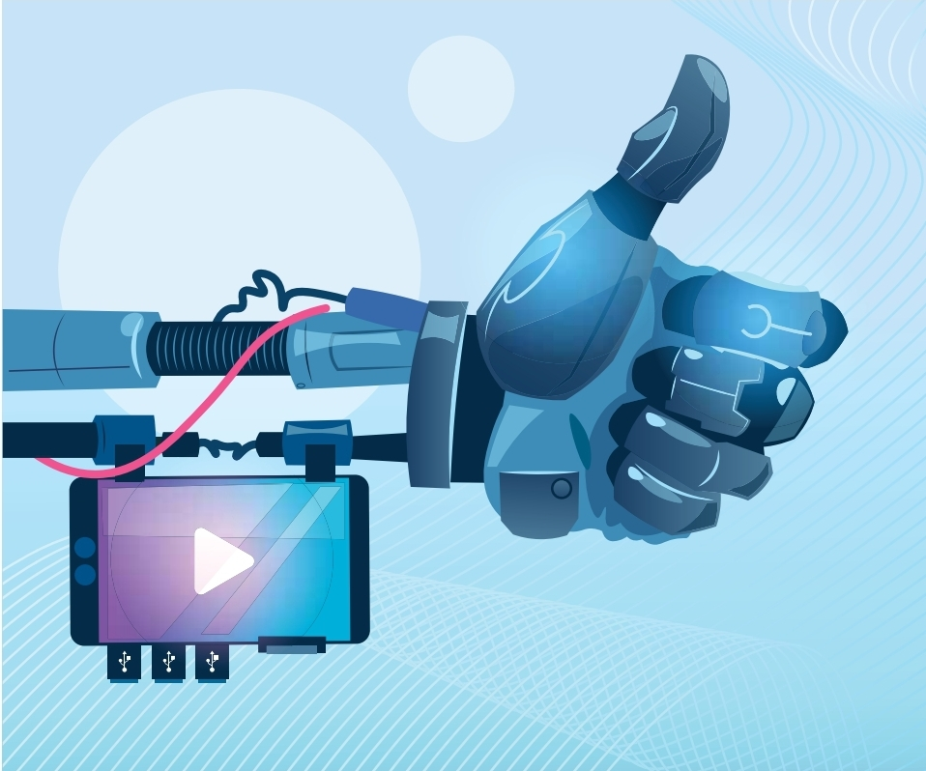
Building blocks of chatbots:
The chatbot consists of these key components:
• A front-end interface, which connects to a variety of channels, such as websites, email, SMS, or messaging applications such as Facebook Messenger or Slack, through which users interact with the chatbot.
Understanding intent is responsible for recognizing the user’s intent. This element uses natural language processing and machine learning to parse user messages, collect relevant parameters from words and sentences, and map those to actions to take.
Another component manages the dialogue by maintaining a representation of the conversational logic and keeping track of context
Notes:
Chatbots can be considered as an enhanced channel of customer interaction which would move from Interactive Voice response to Intelligent Assistant Response.

Slide 7
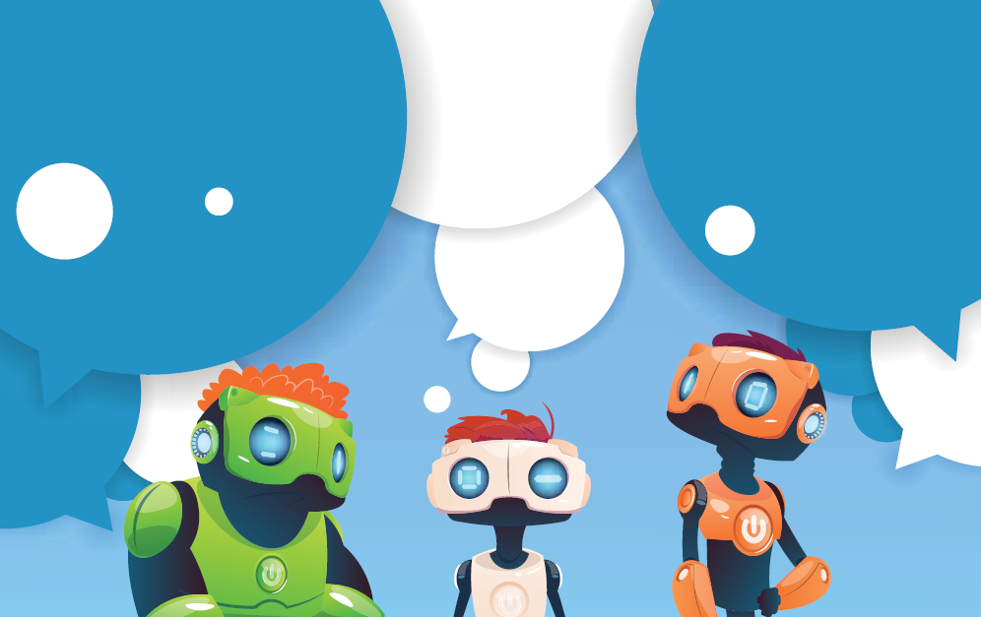
Do Chatbots have inherent advantages over humans
Chatbots have a number of potential benefits over traditional GUIs. First, they can simplify applications for users. For example, rather than navigating through an interface or website to find information, users can just say or type what they want.
Second, the conversational UIs that chatbots offer may require little to no training, given that they understand and can interpret natural language and translate it into actions.
Third, users can leverage chatbots to operate several business applications at once

Slide 8
Why are chatbots steadily gaining attention?
Advancements in technologies and computing power have enabled chatbots to gain traction from major technology giants as early adopters. With advances in Natural Language Processing and Artificial Intelligence, machine learning algorithms can now understand queries just like the humans.
Human Resource companies informally refer to Chatbots as a friend who helps you with tasks such as booking a flight ticket, reminding you to punch in for your attendance, sending a note to your newly joined team member or even training you for the next job interview.
Some chatbots can help with employee performance reviews and engagement while another can simplify the recruitment process through Artificial Intelligence

Slide 9
There are two kinds of chatbots in the market today: Scripted bots and Artificial Intelligence (AI) bots.
Scripted bots | Artificial Intelligence (AI) bots
Scripted bot is like a rule-based guided conversation and performs like a decision tree where each action by the user prompts the bot to take action or respond. | AI bots are built on Machine Learning (ML) and Natural Language Processing (NLP) capabilities.
The bot engages users with questions about makeup preferences and serves up content and offers relevant to their responses. Example:- NatGeo Genius, Click Z | They are based on the human capability of learning and absorbing information owing to which they are more efficient and can process much faster. Example:- Sentinel,Google Assistant,SIRI

Slide 10
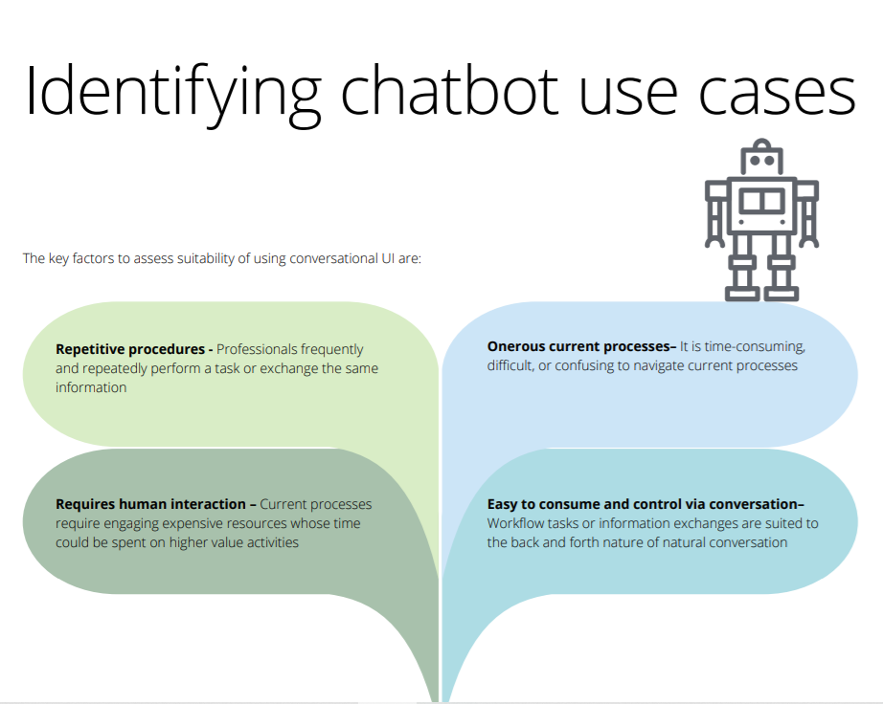

Slide 11
Enterprises are finding multiple areas to deploy chatbots
*Chatbots are increasingly being implemented in two domains: business to business and internal. The bot phenomenon will cause broad disruption in many areas of the economy.*
Global organizations are taking bots developed by them to the next level.
A user in the US can simply ask Alexa to order an Uber, and she will request a ride right to your door. This bot developed by Amazon is a personal assistant that listens to you through a number of physical devices that use her (Alexa) as their brain.
This was made possible as a result of integrating Uber API with the bot.

Slide 12
References
Cioandleader.com
Deloitte Analysis
GitHub
Stack Overflow
Data Camp

Slide 13
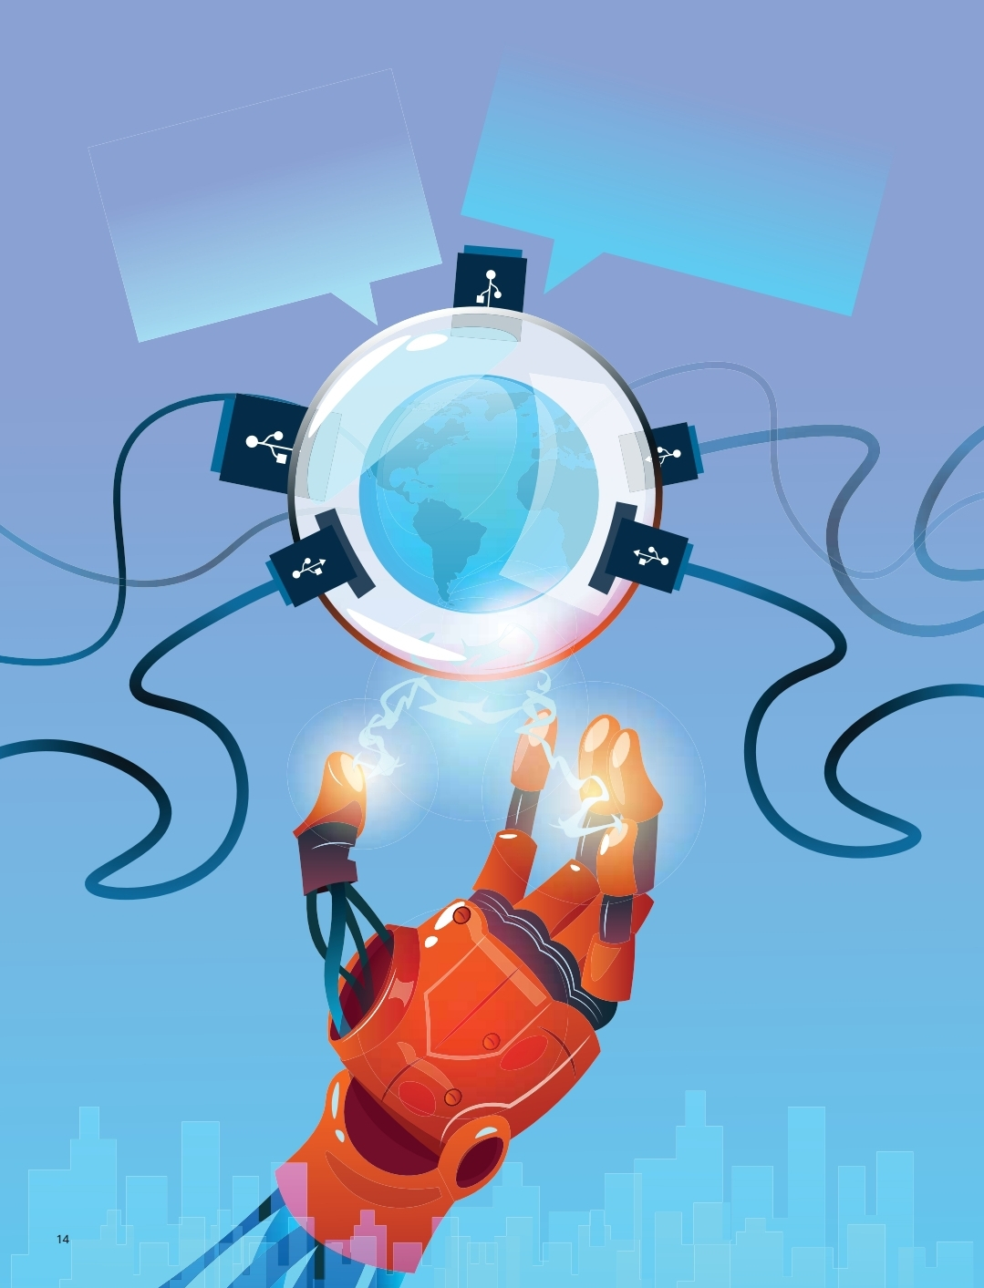
GROUP MEMBERS
THANK YOU
HARSH DESHPANDE
YASH JADHAV
Komal Sawant

